Slide 1
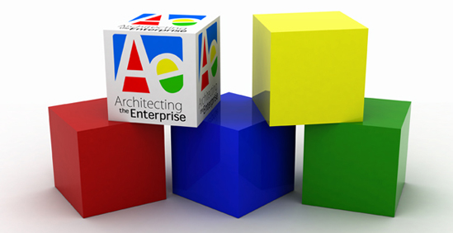
TOGAF™
The Open Group
Architecture Framework
Presented by
Steve Else, Ph.D.
Decisive Strategies, Inc.

Slide 2
Agenda
The Open Group
The Architecture Forum
TOGAF
  Background
  TOGAF 8 “Enterprise Edition”
  A look ahead to the next revision of TOGAF
Summary

Slide 3
The Open Group

Slide 4
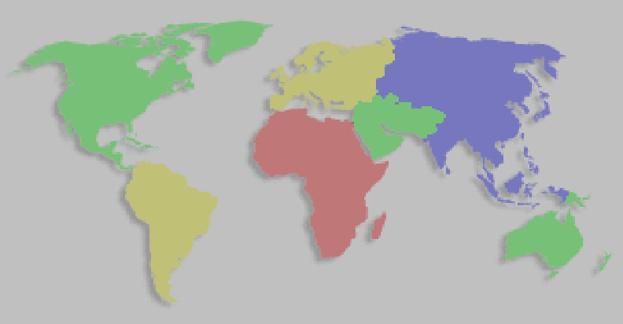
About The Open Group
Global Operation
Cross-Industry
Vendor Neutral
Technology Neutral
San Francisco,
Boston, UK, Tokyo
Regional chapters
50+ staff
Brings the key
constituencies together
in an open process
Operates the industry’s
premier
certification service
Industry Consortium
Not-for-profit operations
Established >20 years
~250 member organizations
Notes:
The Open Group is a vendor-neutral and technology-neutral consortium, whose vision of Boundaryless Information Flow™ will enable access to integrated information within and between enterprises based on open standards and global interoperability. The Open Group works with customers, suppliers, consortia, and other standards bodies. Its role is to capture, understand, and address current and emerging requirements, establish policies, and share best practices; to facilitate interoperability, develop consensus, and evolve and integrate specifications and Open Source technologies; to offer a comprehensive set of services to enhance the operational efficiency of consortia; and to operate the industry's premier certification service.
Further information on The Open Group is available at www.opengroup.org.
The Open Group has over 15 years’ experience in developing and operating certification programs and has extensive experience developing and facilitating industry adoption of test suites used to validate conformance to an open standard or specification.
The Open Group publishes a wide range of technical documentation, the main part of which is focused on development of Technical and Product Standards and Guides, but which also includes White Papers, Technical Studies, and Business Titles.
A catalog is available at www.opengroup.org/bookstore.

Slide 5
Mission and Strategy
Mission:
  Drive the creation of Boundaryless Information Flow.
Strategy:
  Work with customers to capture, understand and address current and emerging requirements, establish policies and share best practices.
  Work with suppliers, consortia and standards bodies to develop consensus and facilitate interoperability, to evolve and integrate open specifications and open source technologies;
  Develop and operate the IT industry's premier certification service and encourage procurement of certified products.
Notes:
The role of the Open Group is to help buyers and suppliers to work together for the creation of boundaryless information flow by developing standards and working with other standards organizations, and to ensure the interoperability of IT products through the delivery of testing and certification.

Slide 6

Activities
Certification Services
  For specifications of The Open Group and other consortia
Conferences
  Quarterly member meetings
  Architecture Practitioners Conferences
Member Forums and Technical Working Groups
  Adaptive Business Solutions, Architecture,
  Business Architecture,Management,
  Grid Enterprise Services, Identity,
  Jericho Forum (de-perimiterization)
  Platform,
  Real Time & Embedded,
  Security, UDEF, SOA,
  Semantic Interoperability
Notes:
This is a summary slide. There is more detail on each of these areas in the following slides.
The Open Group activities can be divided into these areas, each focussed on the vision of boundaryless information flow and the mission of driving it’s creation.
The Architecture Forum is highlighted since that is the group that develops TOGAF.
The Universal Data Element Framework (UDEF) is a cross-industry metadata identification strategy designed to facilitate convergence and interoperability among e-business and other complex federal standards. The objective of the UDEF is to provide a means of real-time identification for Semantic equivalency, as an attribute to data elements within e-business document and integration formats.

Slide 7
Forums/Work Areas of The Open Group
Meeting points for Suppliers and Buyers
Each Forum is effectively an autonomous consortium operating within The Open Group
  Direction determined by members
  Outputs approved by members
  Must obey some rules to respect anti-trust legislation
Forums initiate new areas of work, often in partnership with other Forums
  …leading to industry standards
  …leading to certification programs based on those standards
Notes:
All members of The Open Group are entitled to participate in selected work areas in which we work with suppliers, consortia and standards bodies to develop consensus and facilitate boundaryless information flow, to evolve and integrate open specifications and open source technologies.
The major message is that the Forums and Work Areas are where Customers and Vendors come together to execute the work of The Open Group.
The value to customers is that The Open Group addresses real needs.
The value to vendors is that they are able to design products to meet real needs.
Once we have established requirements, The Open Group encourages dialogue between customers and suppliers and work with other consortia working in the same area.
We group these work areas into packages, called Forums. Although some work areas are relevant to more than one Forum so members of both may participate.

Slide 8
The Architecture Forum

Slide 9


Architecture Forum - Focus
Original (and continuing) focus:
  TOGAF
Target
ADM
TRM
SIB
BBIB
Resource Base
TOGAF
Extended focus:
  Architecture as a Professional discipline
  Architecture Tools

Slide 10
Stakeholders and Value
Customer Architects: Reduced time, cost, risk
  procuring effective IT architecture tools
  developing an IT architecture
  procuring products to implement an IT architecture
Tools Vendors: Bigger market, bigger market share
  supporting open methods for architecture
IT Solution Vendors: Greater cost-efficiency
  reduced cost of bidding, greater share of procurements
Integrators: Greater cost-efficiency, better service
  better service delivery to clients
  more effective use / re-use of own architecture assets
Academic / Research Organizations: Funding support
  demonstrated relevance to market, route to standardization
  “technology transfer” important in bids for funding

Slide 11
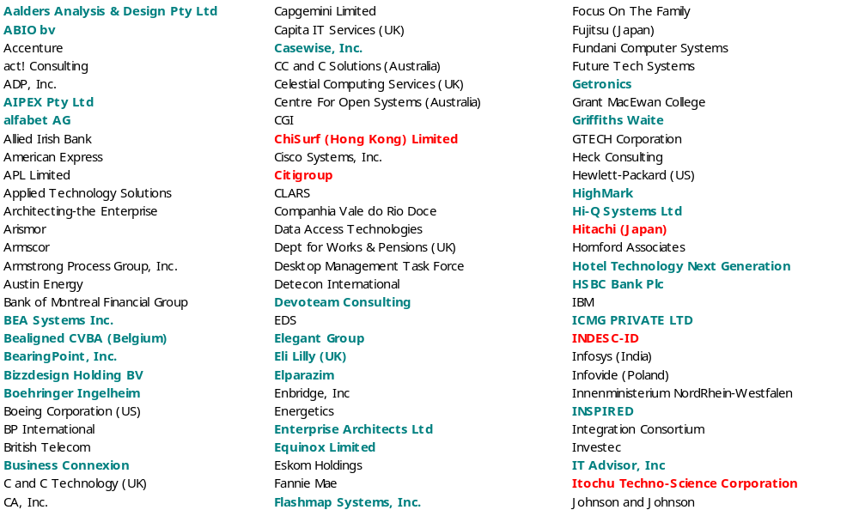
Membership List – Dec 31st, 2007
172 current members

Slide 12
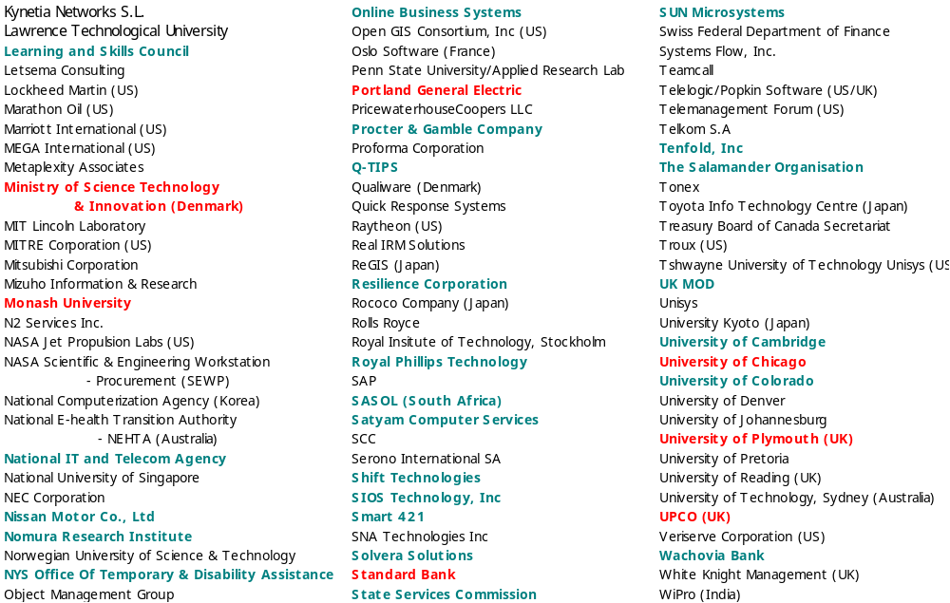
Membership List – Dec 31st, 2007

Slide 13
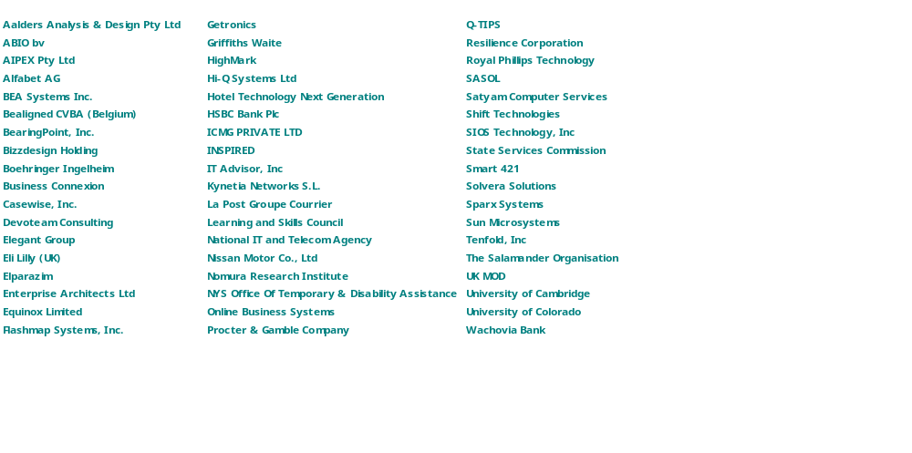
New Members 2007

Slide 14
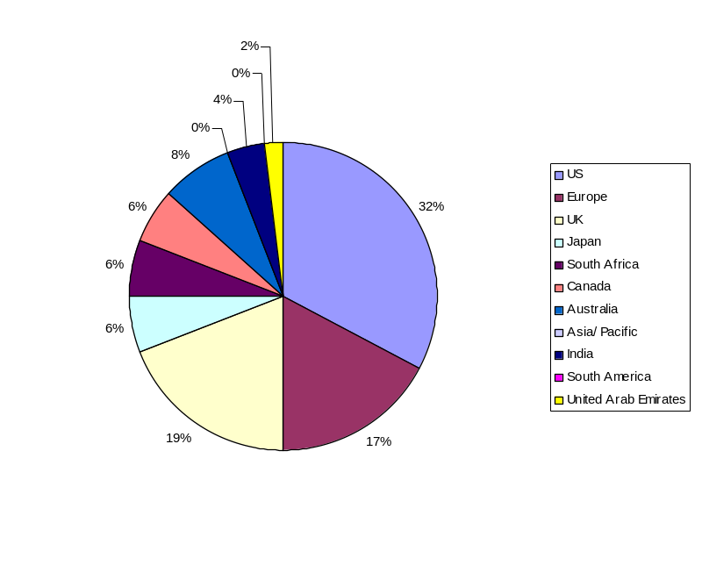
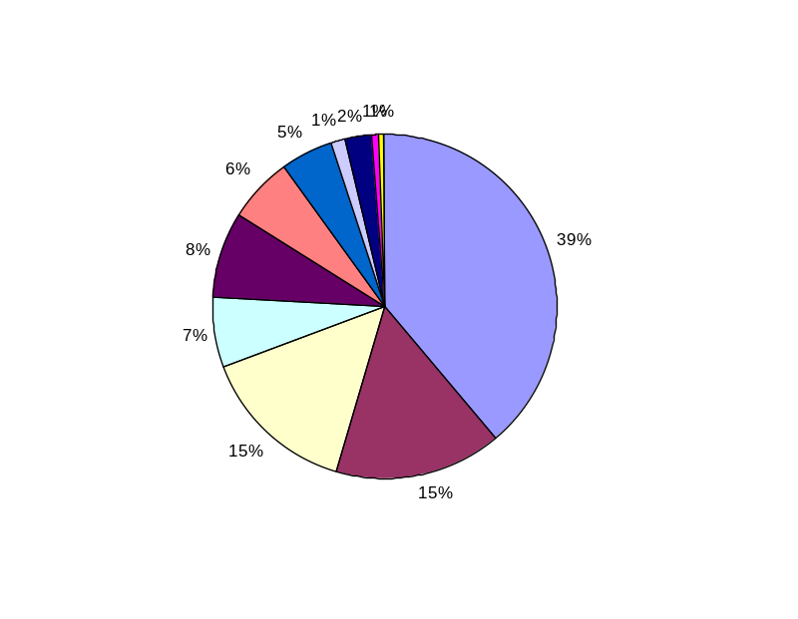
Forum Members – By Geography
New Members 2007
All Members

Slide 15
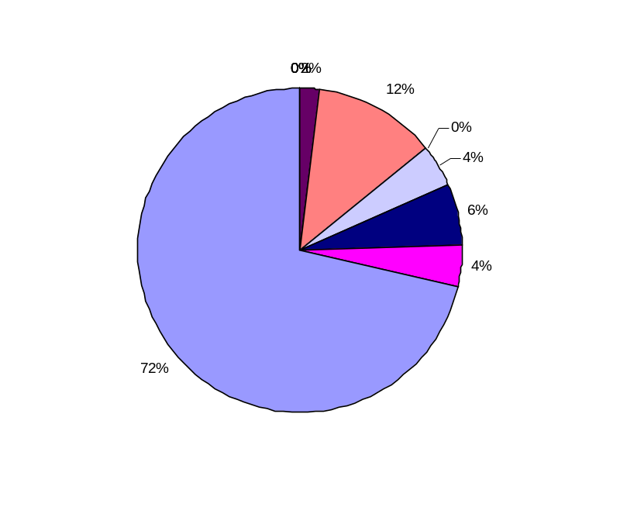
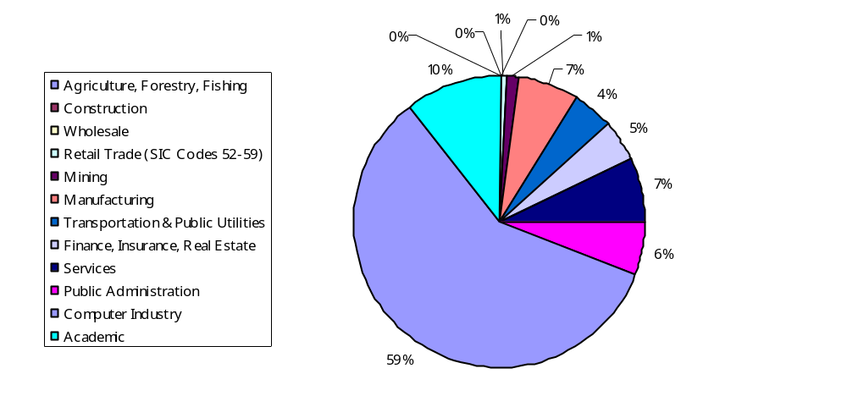
Forum Members – By Vertical
New Members 2007
All Members

Slide 16
TOGAF 8 “Enterprise Edition”

Slide 17
TOGAF Origins
A customer initiative
A framework, not an architecture
  A generic framework for developing architectures to meet different business needs
  Not a “one-size-fits-all” architecture
Originally based on TAFIM (U.S. DoD)
Notes:
June 20, 2007

Slide 18

Member (End User) Driven
Customer members demand architecture standards …
Customer members select TAFIM as preferred starting point…
DoD Information Systems Agency (DISA) donate TAFIM as base
TOGAF first published
‘93
TOGAF 7 – Technical Edition
‘94
‘96
‘01
‘02
‘03
TOGAF 8
Enterprise Edition
The Interoperable Enterprise
Business Scenario
first published
First TOGAF Certification
Program Launched
Notes:
This is an alternate view of the timeline , this again illustrates the long maturation cycle.

Slide 19
TOGAF Development
1994: Requirement
1995: TOGAF Version 1
1996: TOGAF Version 2
1997: TOGAF Version 3
1998: TOGAF Version 4
1999: TOGAF Version 5
2000: TOGAF Version 6
2001: TOGAF Version 7
2002: TOGAF Version 8
2003: TOGAF Version 8.1
2006: TOGAF Version 8.1.1
  Proof of need
  Proof of concept
  Proof of application
  Relevance to practical architectures (building blocks)
  Enterprise Continuum (TOGAF in context)
  Business Scenarios (architecture requirements)
  Architecture views - IEEE 1471
  Architecture Principles; Compliance Reviews
  Extension to Enterprise Architecture
  Requirements Management;
  Governance; Maturity Models; Skills Framework
  Technical Corrigendum 1 applied
Notes:
June 20, 2007
Brief review of development to date:
2H94 requirement - demonstrated real need
1995 - hand-picked group of customer & vendor experts (Architecture Task Force)
first version of Framework published Dec 95, as X/Open A/F
deficiencies, but demonstrated proof of concept
many had doubted feasibility of a consensus arch f/w
1996 - Arch Task Force continued, embraced work of OSF community
second version published as TOGAF, builds on XAF, integrates arch. work of OSF community => stable, robust f/w
case studies of TOGAF used in significant projects for design and procurement of open system solution
vendor commitments to develop mappings to TOGAF from own product architectures
NCR / OCCA there already, IBM / Open Blueprint committed, discussions ongoing with other vendors
Next logical progression - build critical mass
greater relevance to specific architectural implementations
address key deficiencies

Slide 20
TOGAF 8 Scope
TOGAF 8 covers the development of four related types of architecture:
  Business architecture
  Data or information architecture
  Application architecture
  Technology architecture
TOGAF 8
“Enterprise Edition”
TOGAF 7 “Technical Edition”

Slide 21
TOGAF 8 Goals
Long-term:
  An industry standard, generic enterprise architecture method….
  ….usable in conjunction with frameworks having products relevant / specific to particular sectors.
    Several frameworks have mindshare:
      Zachman, Spewak, DoD Framework, FEAF, TEAF, …
    Almost all focus on products, not method
    TOGAF and…. (not TOGAF or….)
Version 8:
  An overall structure and core method for enterprise architecture that can be filled out in future years.

Slide 22
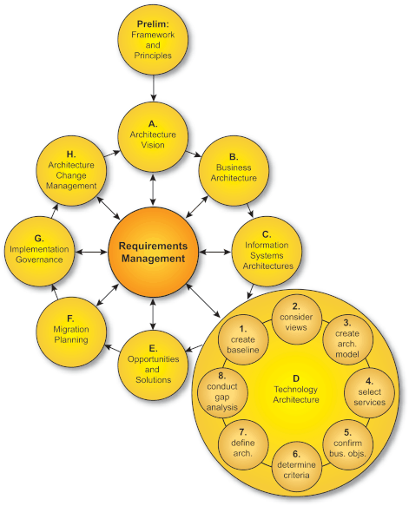
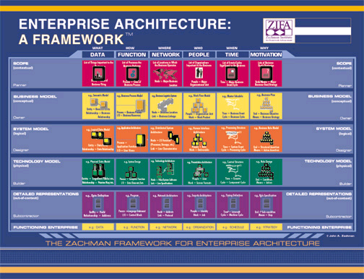
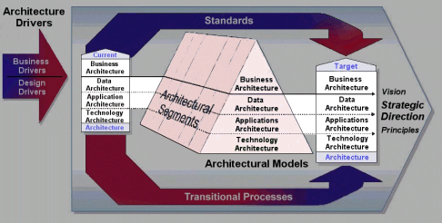
Supporting industry integration
TOGAF
Support or
Guidance
Zachman Framework
TOGAF ADM
Architecture Development Method
Federal Enterprise
Architecture Framework
Other Frameworks

Slide 23
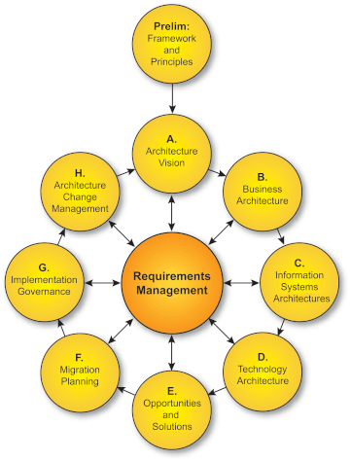
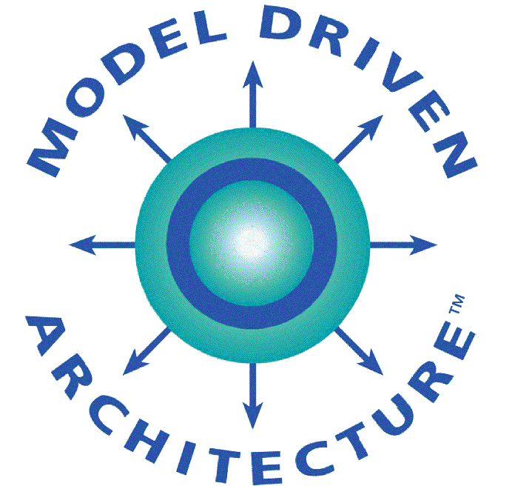
TOGAF/ MDA Alignment
TOGAF ADM
  Enterprise Architecture Development Method
TOGAF or any other framework
The OMG Model Driven Architecture
  A Software Architecture and Development Approach

Slide 24
TOGAF and Other Frameworks / Bodies of Knowledge
TOGAF8 already contains mapping to Zachman Framework
Recent White papers:
  http://www.opengroup.org/architecture/wp/
  Mapping TOGAF to OMG’s MDA modeling standards
  Mapping TOGAF8 and DODAF
  Mapping TOGAF8 and COBIT4
  Mapping TOGAF8 and ITIL touchpoints

Slide 25
TOGAF 8 Components
Architecture Development Method (ADM)
Reference Architectures
  Foundation Architecture
    Technical Reference Model
    Standards Information Base
  Integrated Information Infrastructure Reference Model
    Supporting “Boundaryless Information Flow”
  Enterprise Continuum
Resource Base
Notes:
June 20, 2007

Slide 26
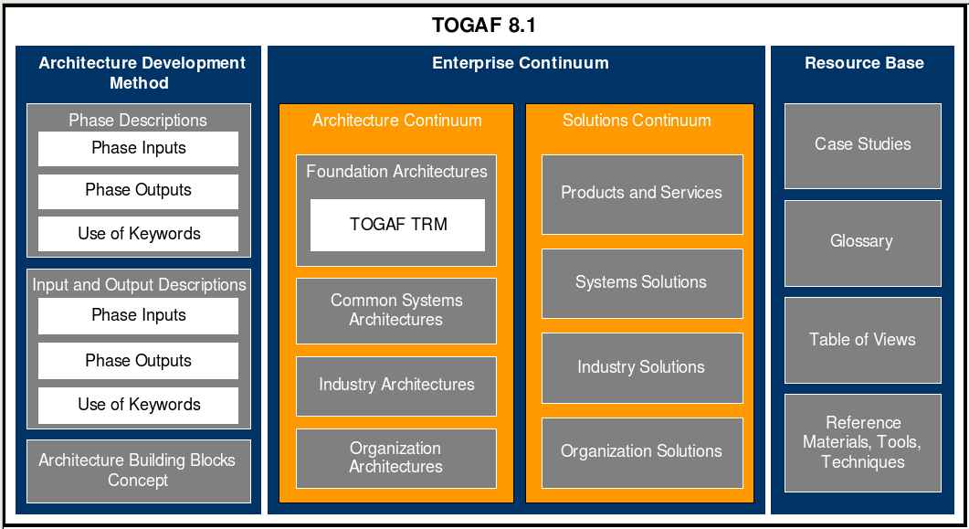
TOGAF 8 Components
Source: SAP and Capgemini
Notes:
June 20, 2007

Slide 27
TOGAF 8 “Enterprise Edition”
Architecture Development Method
Overview

Slide 28
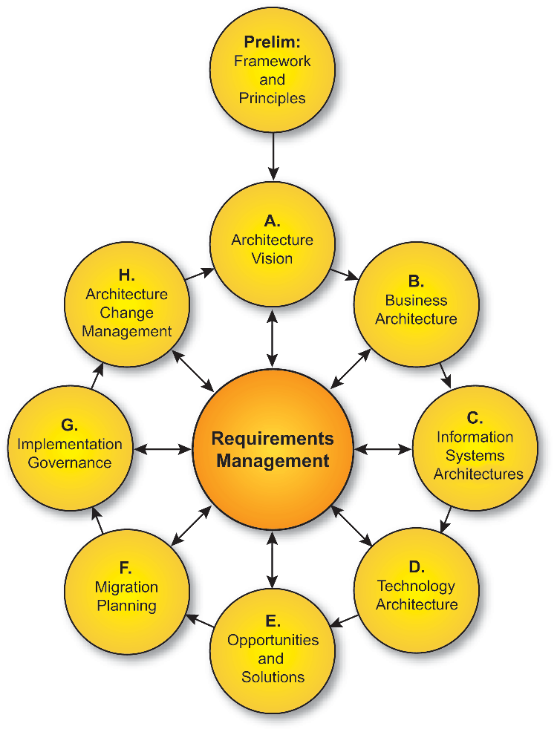
ADM – Basic Principles
An iterative method, over the whole process, between phases and within phases
Each iteration = new decisions:
  Enterprise coverage
  Level of detail
  Time horizon
  Architecture asset re-use:
    previous ADM iterations
    other frameworks, system models, industry models,…)
Decisions based on:
  Competence / resource availability
  Value accruing to the enterprise.

Slide 29
ADM – Basic Principles
Every phase is validated against and validates the current requirements of the business

Slide 30
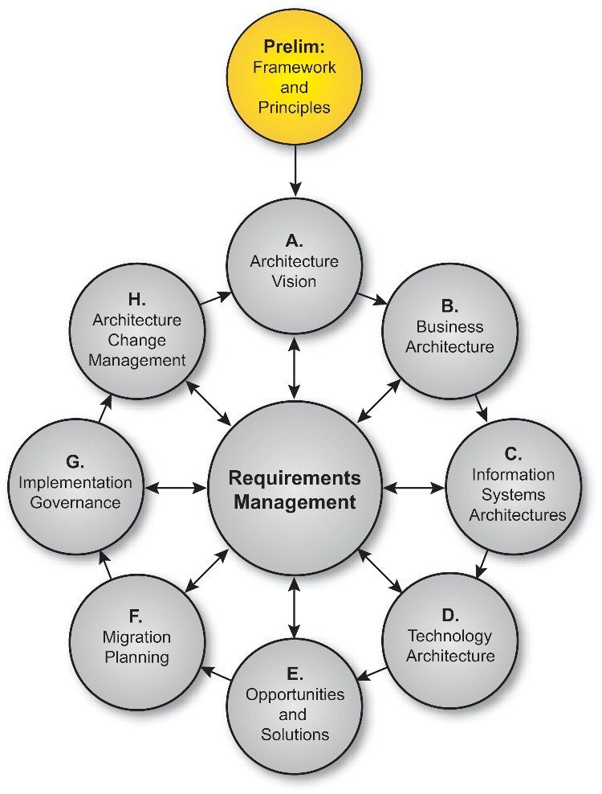
Preliminary Phase: Frameworks & Principles
This phase prepares the organization for undertaking Enterprise Architecture successfully
  Understand business environment
  Commitment of key stakeholders
  Agreement on scope
  Establish principles
  Establish governance structure
  Agree method to be adopted

Slide 31
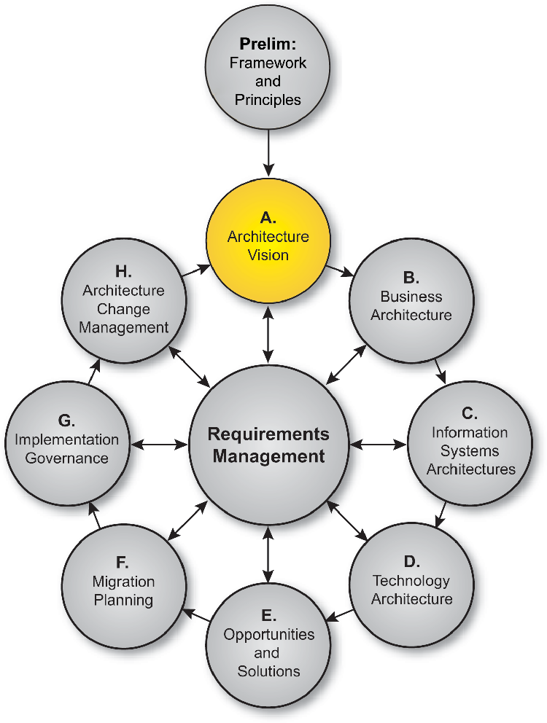
Phase A: Architecture Vision
Initiates one iteration of the architecture process
  Sets scope, constraints, expectations
  Required at the start of every architecture cycle
Validates business context
Creates Statement of Architecture work

Slide 32
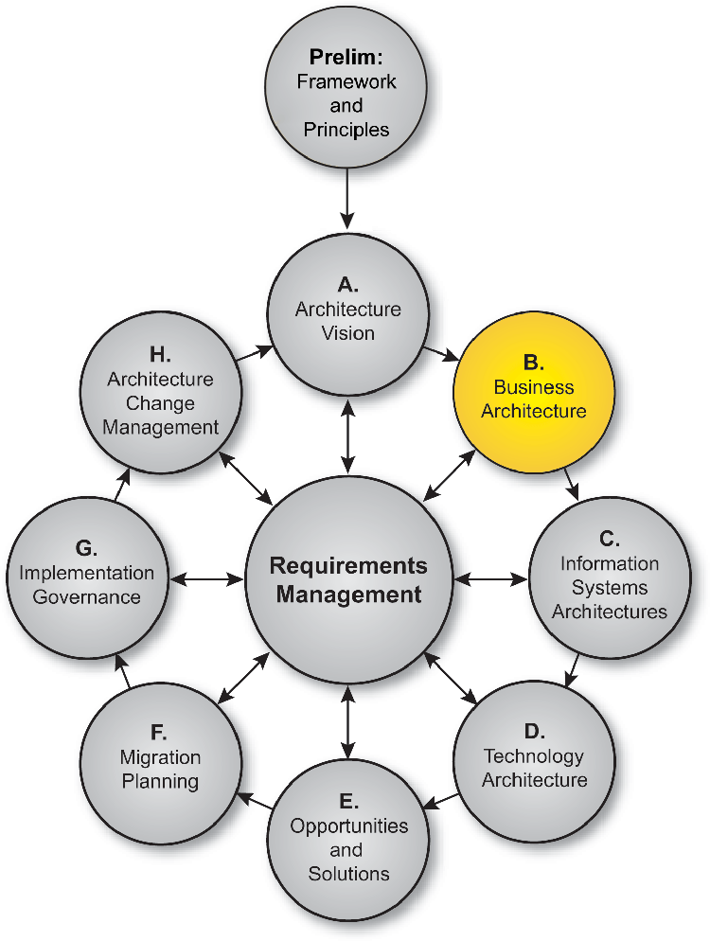
Phase B: Business Architecture
The fundamental organization of a business, embodied in
  its business processes and people,
  their relationships
    to each other and the environment,
  and the principles governing its design and evolution
Shows how the organization meets it’s business goals

Slide 33
Phase B: Business Architecture - Contents
Organization structure
Business goals and objectives
Business functions
Business Services
Business processes
Business roles
Correlation of organization and functions.

Slide 34
Phase B: Business Architecture - Steps
Confirm context
Define baseline
Define target
  Views are important
Validate
  Requirements
  Concerns
Perform Gap analysis
Produce report

Slide 35
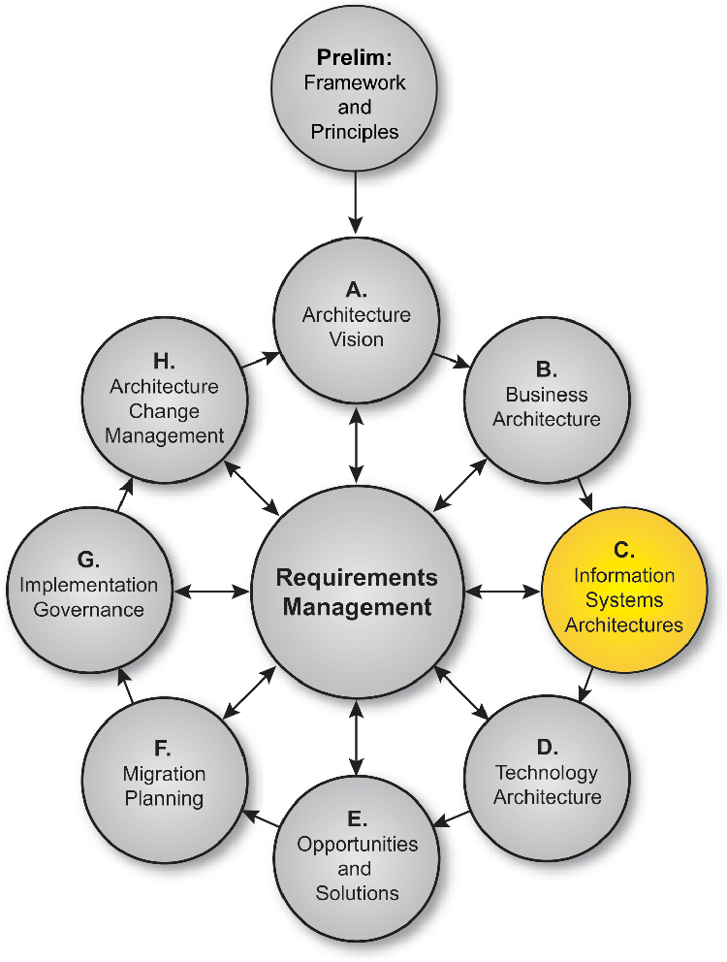
Phase C: Information Systems Architectures
The fundamental organization of an IT system, embodied in
  relationships to each other and the environment, and the principles governing its design and evolution
Shows how the IT systems meets the business goals of the enterprise
Continued

Slide 36
Phase C: Data or Applications first ?
It is usually necessary to address both
  Not always the case, depending on project scope and constraints
May be developed in either order, or in parallel
  Theory suggests Data Architecture comes first
  Practical considerations may mean that starting with Application Systems may be more efficient
There will need to be some iteration to ensure consistency

Slide 37
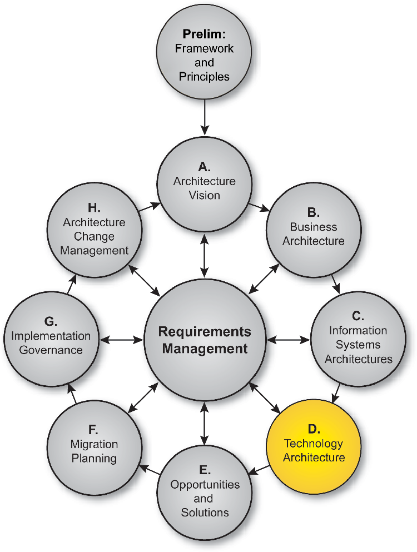
Phase D: Technology Architecture
The fundamental organization of an IT system, embodied in
  its hardware, software and communications technology
  their relationships to each other and the environment,
  and the principles governing its design and evolution

Slide 38
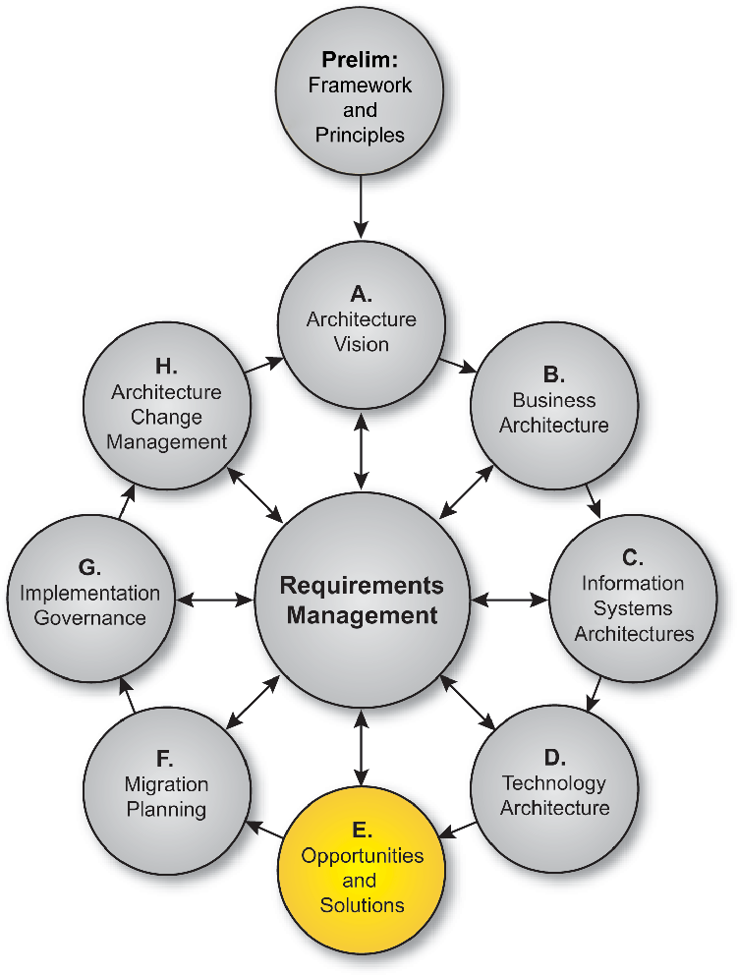
Phase E: Opportunities and Solutions
Identify the major implementation projects
Decide on approach
  Make v Buy v Re-Use
  Outsource
  COTS
  Open Source
Assess priorities
Identify dependencies

Slide 39
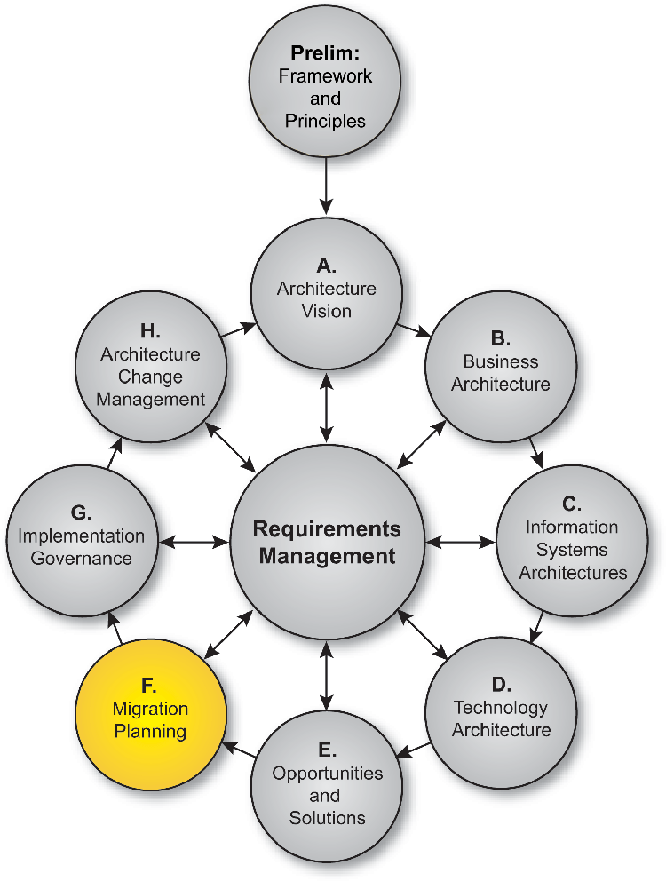
Phase F: Migration Planning
For projects identified in Phase E perform
  Cost/benefit analysis
  Risk assessment
Produce an implementation road-map

Slide 40
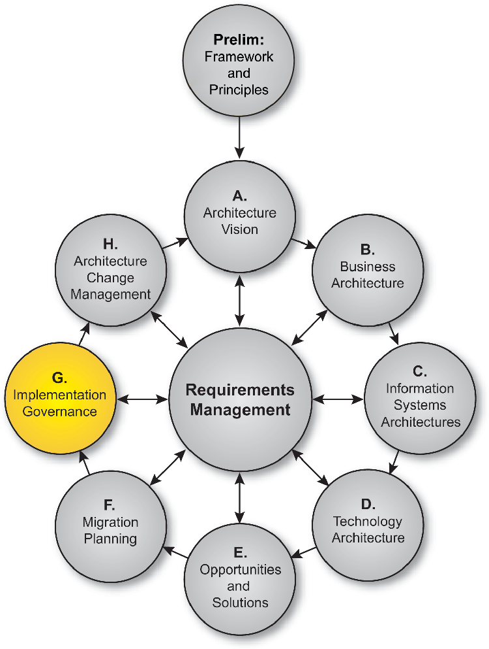
Phase G: Implementation Governance
Defines architecture constraints on implementation projects
Architecture contract
Monitors implementation work for conformance

Slide 41
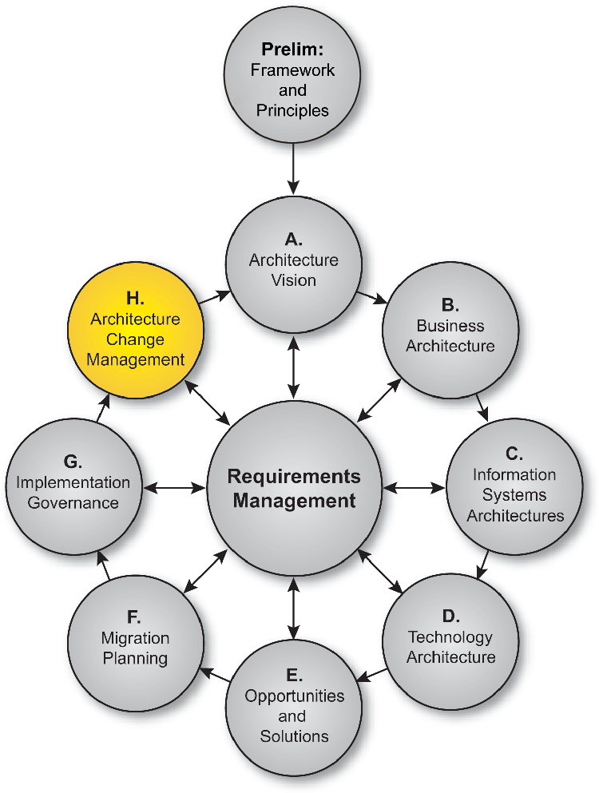
Phase H: Architecture Change Management
Ensures that changes to the architecture are managed in a cohesive and architected way
Establishes and supports the Enterprise Architecture to provide flexibility to evolve rapidly in response to changes in the technology or business environment

Slide 42
TOGAF 8 “Enterprise Edition”
Reference Models

Slide 43
Foundation Architecture: TRM
Qualities
Qualities
Infrastructure
Applications
Business
Applications
Associated with detailed taxonomy of services
  defines scope of each service category
Identifies system-wide capabilities or “qualities”; e.g.:
  Internationalization
  Security
  Management
Application Programming Interface
Security
Location & Directory
System & Network Management
Transaction Processing
User Interface
International Operations
Data Interchange
Data Management
Qualities
Graphics & Image
Software Engineering
Qualities
Operating System Services
Network Services
Communications Infrastructure Interface
Communication Infrastructure
Notes:
June 20, 2007
The detailed Technical Reference Model presents the TRM entities and interfaces, including the service categories of the Platform and the sub-entities of the External Environment. The diagram neither implies nor inhibits relationships among the service categories.
The detailed TRM shows two different kinds of Platform Service category:
Categories on the front face have functionality that is self-contained, in that its proper implementation system-wide depends only on proper implementation of the services in that category. Functionality in these service categories delivers services for use by applications through an API.
Categories on the right hand face, orthogonal to the front face, relate to cross-category services. Services in these categories have functionality that requires consistent implementation in software from all other relevant service categories. Functionality in these service categories not only provides applications with services (through an API ), but gives the system some attributes which affect its behavior without necessarily being under direct application control.
TOGAF identifies a generic set of platform services. In a specific target architecture not all these services may be present, since the platform contains only the services needed to support the required functions. Also, a particular organization may need to augment these with services or service categories that are considered to be generic in its vertical market segment (e.g., “trouble-ticketing” services in a Telco-specific platform).
The set of services provided by the platform will change over time. As technology develops, the model will need to be extended to include new types of service and as application needs change.
As well as supporting application software through the API, services will support each other, either by architected interfaces which may or may not be the same as the API, or by private, unexposed interfaces. Such service modules should be capable of replacement by modules providing the same service functionality via the same service API. Use of private, unexposed interfaces among service modules may compromise this substitutability. These private interfaces represent a risk that should be highlighted to facilitate future transition.

Slide 44
Foundation Architecture:
Standards Information Base (SIB)
A database of open industry standards
Content determined by Open Group consensus process
Structured according to TOGAF Technical Reference Model taxonomy
Available for public web access
  http://www.opengroup.org/sib/
Gateway to many linked resources
Notes:
June 20, 2007
The SIB lists all the standards and specifications recommended by The Open Group for use in open systems architectures.These comprise the current X/Open CAE Specifications, and relevant International standards adopted by The Open Group as having the same status as CAE Specifications. It also lists all the current X/Open branding definitions.
The tables are structured according to the service areas in the TRM and its taxonomy:
Data Interchange Services
Data Management Services
Distributed Computing Services
Graphics Services
Network Services
Object Management Services
Operating System Services
Software Engineering Services
Transaction Processing Services
User Interface Services
Internationalization Services
Security Services
System Management Services
There are hyperlinks from most entries in the SIB to details of the referenced specification or standard, held either on The Open Group web server (in the case of CAE Specs and branding definitions) or the web sites of other standards organizations (ISO, IETF, IEEE).

Slide 45
Integrated Information Infrastructure Reference Model
A model of the key components for developing, managing, and operating an integrated information infrastructure.
  Supporting “Boundaryless Information Flow”
A model of a set of applications that sit on top of an application platform.
An expanded subset of the TOGAF Technical Reference Model, using different orientation.

Slide 46
Integrated Information Infrastructure Reference Model
Detailed Model
Qualities
Qualities
Security
Mobility
Application Platform
Information Consumer Applications
Web Portal
Desktop Video Conference
Streaming audio / video
information Access
Mail
Phone / Fax
Directory
Referencing/Dereferencing
Naming
Registration
Publish
Subscribe
Discovery
Application Message Format
Presentation
Transformation
Browser services
Portal and personalization
Meta indices
Application Messaging
Languages Libraries
Registries
Application to application communications services
Enterprise Appl Integration
Development Tools
Brokering Applications
Management Utilities
Monitors
Executory Utilities
Copy Managers
Business modeling tools
Design tools
Construction tools
Languages and Libraries
Information Brokers
Application Integrators
Digital Signature
Intrusion Detection
Key Management
Firewall
Encryption
AAAC
SSO
Info Format
eForm services
Instant messaging services
Information Access
Transformation Mapping
Query distribution
Aggregation
Search
File services
Web services
Information Provider Applications
Web Portal
Desktop Video Conference
Streaming audio / video
information Access
Mail
Phone / Fax
Messaging/Event Brokering
Process/Workflow Control
Performance
Manageability
Notes:
June 20, 2007
Not to complicate things, but there are further detailed views that need be exposed and models such as this one provide a little more detail that the level 1 diagram. This is the diagram that needs to be fully populated with the right things. Right now this is just been populated for demonstration purposes where it shows the level of detail we need to get to.

Slide 47
The “Enterprise Continuum”
Architecture Continuum
Foundation
Architectures
Common Systems
Architectures
Industry
Architectures
Organisation
Architectures
Guides &
Supports
Guides &
Supports
Guides &
Supports
Guides &
Supports
Products &
Services
Systems
Solutions
Industry
Solutions
Organisation
Solutions
Solutions Continuum
Notes:
June 20, 2007
Foundation Architecture - TOGAF
Common Systems Architecture – Security, Manageability, etc.
Industry Architecture - ARTS
Organization Architecture - Dairy Farm Group

Slide 48
TOGAF 8 “Enterprise Edition”
Resource Base

Slide 49
Resource Base
Architecture Board: Guidelines for establishing and operating an Enterprise Architecture Board
Architecture Compliance: Guidelines and checklists for ensuring project compliance to architecture
Architecture Contracts: Guidelines for architecture contracts
Architecture Governance: Arrangements for effective control of IT Architecture by enterprise management
Architecture Patterns: Guidelines on architecture patterns
Architecture Principles: Guidelines on developing Architecture Principles; and a generic set of Architecture Principles
Architecture Views: Guidelines for developing viewpoints and views in architecture models
Building Blocks Example: Example illustrating use of building blocks in architecture

Slide 50
Resource Base (continued)
Business Process Domain Views: A set of function views aligned with the business process structure of the enterprise
Business Scenarios: A method for deriving business requirements for architecture and the implied technical requirements
Case Studies: Real-life examples of TOGAF in use
Glossary: Definitions of key terms
Other Architectures / Frameworks: and relationship to TOGAF
Tools for Architecture Development: Generic evaluation criteria for architecture tools
Zachman Framework mapping: Mapping the TOGAF ADM to the Zachman Framework

Slide 51
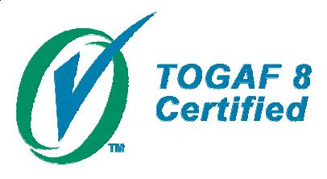
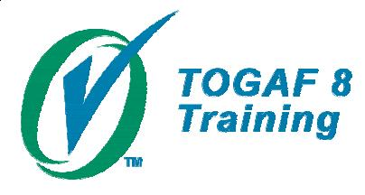
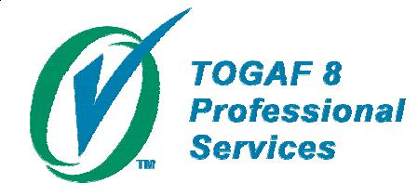
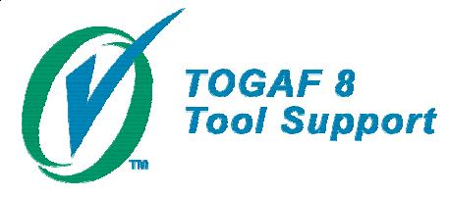
TOGAF Certification
For Individuals
Knowledge based
For organizations providing training courses
Course syllabus meets requirements.
Instructor certified
For organizations providing professional services
Abide by code of practice. Services provided by certified Architects
For organizations providing tools
The tool supports the TOGAF ADM
Notes:
TOGAF 8 Certified
For Individual IT Architects
Certification based on a common core body of knowledge
Certified individuals can
Provide services for organizations certified for TOGAF Professional Services
Be instructors for certified TOGAF Training Courses
TOGAF 8 Training
For Organizations providing Training Courses
Certification based on a common core body of knowledge
Certified individuals can
Provide services for organizations certified for TOGAF Professional Services
Be instructors for certified TOGAF Training Courses
TOGAF 8 Professional Services
For organizations offering professional services in support of TOGAF
Organizations can only use architects who are certified to provide services
TOGAF 8 Tool Support
For organizations providing architecture tools that support TOGAF

Slide 52
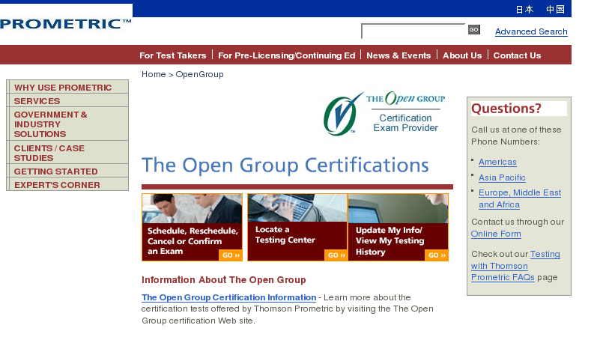
TOGAF 8 global, online testing
Prometric now live……
Notes:
June 20, 2007
TOGAF certification testing is now available worldwide through Prometric with over 2500 test locations in 130+ countries

Slide 53
Some Figures about TOGAF
Developed by 200+ organisations worldwide involved in its development
  Large IT users
  IT vendors
  System Integrators
  Academics
Used in major IT projects worldwide
  IBM, EDS, HP, Sun, Infosys, …..
Community of knowledgeable TOGAF practitioners
  Over 5000 certified
Supported by Architecture Tools
Notes:
Instructors should update the numbers on this slide from time to time…. Check the register at http://www.opengroup.org/togaf/cert/register.html

Slide 54
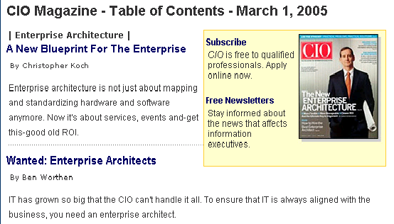

Slide 55
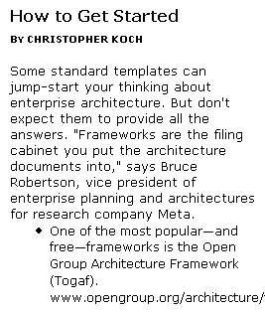


Slide 56
Demand for information
TOGAF™8
  >30,000 downloads
  ~5,000 certified practitioners
> 160 corporate members of
The Open Group Architecture Forum
>3,000 TOGAF 8 books shipped

Slide 57
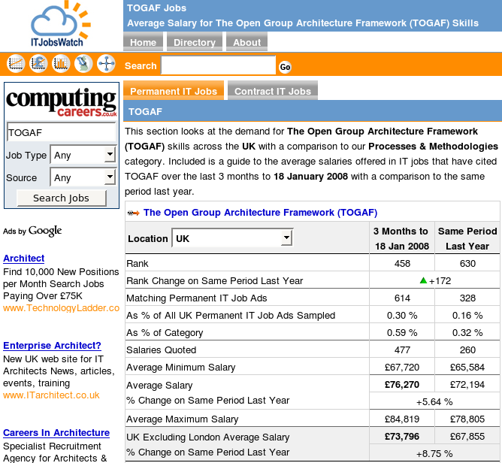
Data as of 18 Jan 2008

Slide 58
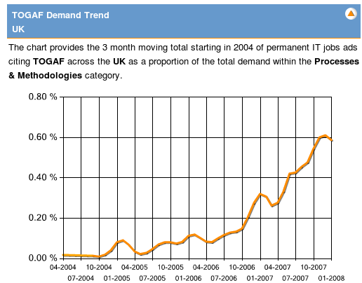
Data as of 18 Jan 2008

Slide 59
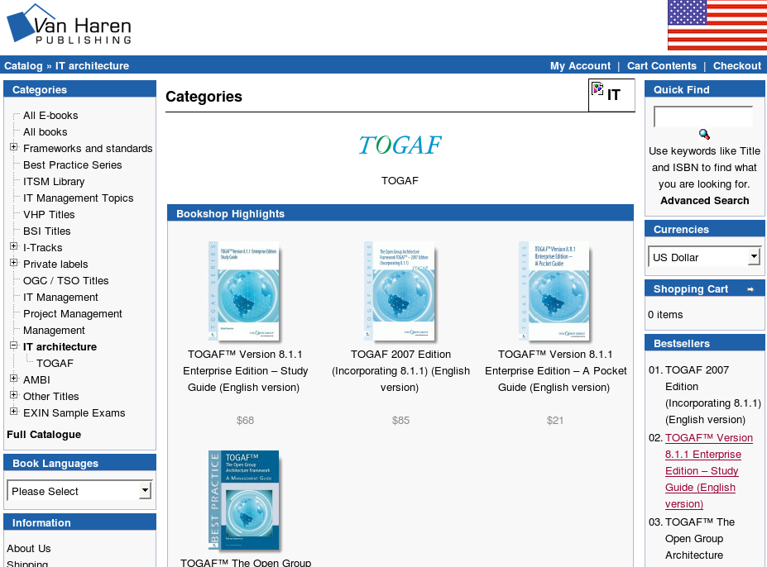
TOGAF 2006 Edition
https://www.vanharen.net
© The Open Group 2008
Notes:
April 12, 2007
This is the store where you can purchase books and downloads

Slide 60
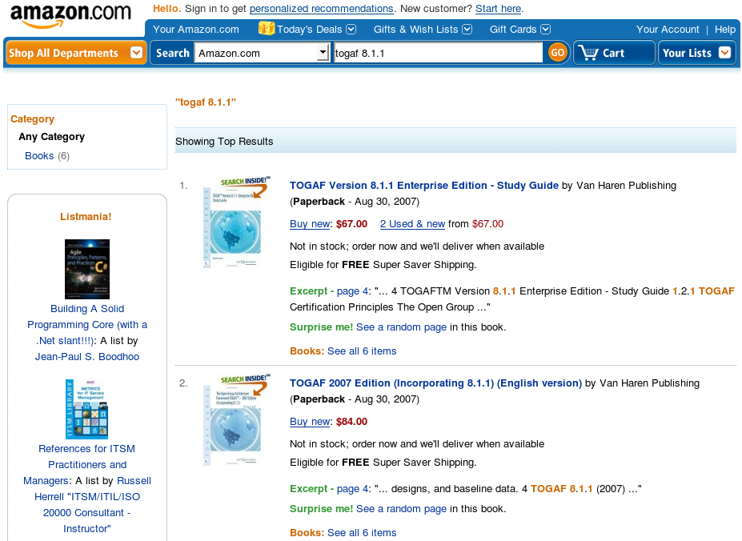
TOGAF 2006 Edition
Notes:
April 12, 2007
This is the store where you can purchase books and downloads

Slide 61
TOGAF 8 Summary
An effective, industry standard framework and method for enterprise architecture.
Complementary to, not competing with, other enterprise frameworks
A repository of best practice
  “Demystifies” architecture development
Vendor, tool, and technology neutral
A framework and method for achieving the “Boundaryless Information Flow” vision
Notes:
This is a brief summary of TOGAF 8.
The value of a framework is that it provides a practical starting point for an architecture project.
The components of TOGAF 8 are as follows:
Architecture Development Method (ADM)
The Enterprise Continuum
The TOGAF Resource Base
TOGAF focuses on the methods, not the products

Slide 62
2008 Revision Objectives
A close alignment with business
Need to make TOGAF easier to use
Evolution not revolution
To produce a new TOGAF standard in a timely and predictable fashion
To publish work of members over the last 4 years

Slide 63
Conclusions
Adopt and use TOGAF
  An effective, industry standard framework and method for enterprise architecture.
  Vendor, tool, and technology neutral
  Complementary to, not competing with, other frameworks
Join and participate in the Architecture Forum
  Worldwide forum for Architecture practitioners
  Network with peers and industry experts
  Contribute to / leverage work in progress
  Help further development of Enterprise Architecture as a discipline and a profession

Slide 64
For More Information . . .
The TOGAF Web Site
  http://www.opengroup.org/togaf/
The Architecture Forum
  http://www.opengroup.org/architecture/
TOGAF Version 8 on-line
  http://www.opengroup.org/architecture/togaf8-doc/arch/
TOGAF Version 8 licensing and downloads
  http://www.opengroup.org/togaf/

